Slide 1

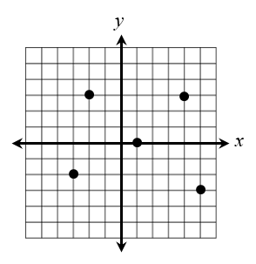
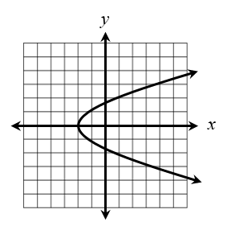
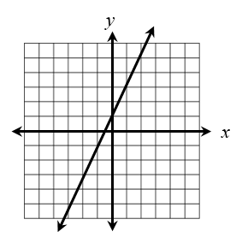

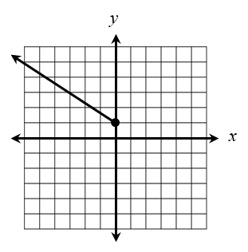
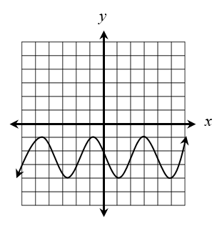
1. Find the range of the relation below, then determine whether the relation is a function.
A. {-3, -2, 1, 4, 5}; Function B. {-3, -2, 1, 4, 5}; Not a function C. {-3, -2, 0, 3}; Function D. {-3, -2, 0, 3}; Not a function
2. Which relations represent a function? Check all that apply.
x
-7
-1
0
5
y
y
2 7 11
-4 -1 3 8
0
6
3. What is the domain of the graph below?
4. What is the range of the graph below?
5. Given the function below, find f (7).
6. Given the functions below, find b(-2) – a(12).

Slide 2

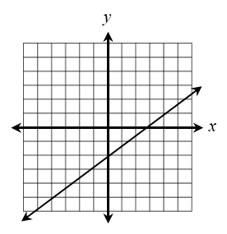
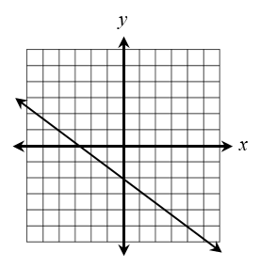
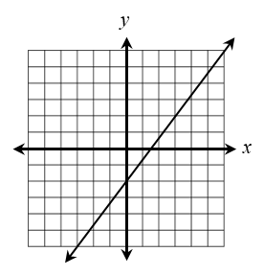
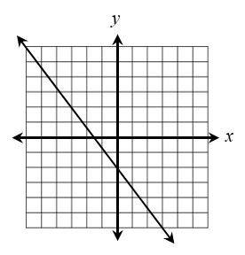
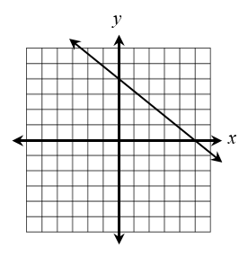
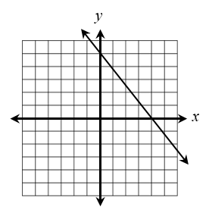
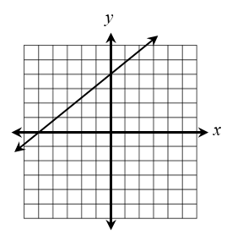
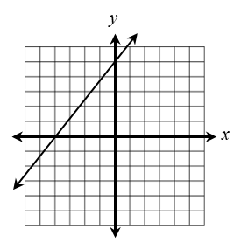
7. Given the function below, find p(x – 1).
8. Given the function below, if h(x) = -1, find x.
x =
9. Write the equation below in standard form.
10. Write the equation below in slope-intercept form.
11. Which graph best represents the equation 12x – 9y = 18?
A.
B.
C.
D.
12. Which graph best represents the equation -15y – 12x = -60?
A.
B.
C.
D.

Slide 3

13. Find the x- and y-intercepts of the equation
below. Write your answers as ordered pairs.
14. Which of the following lines is perpendicular
to the equation given below?
A.
B.
C. D.
x-int.:
y-int.:
15. Give an example of a linear equation that is parallel to the y-axis.
16. Write a linear equation in slope-intercept form that passes through the point (-1, -8) and is parallel to the line 15x + 3y = 21.
17. Write a linear equation in slope-intercept form that passes through the points (-11, -5) and (1, -2).
18. For each boat he sells, Mick earns $149 in addition to 2% of the purchase price of the boat as commission. If p represents the purchase price of the boat, which equation represents Mick’s commission, c?
A. B.
C. D.
19. Angela fully charged her laptop, then unplugged it and tracked the battery level at certain times under constant use. The table below shows her findings. Find an equation for the line of best fit, then estimate the battery level after two hours of constant use unplugged.
Time | Battery Level (%)
2:00 | 100%
2:10 | 94%
2:25 | 87%
2:40 | 83%
3:00 | 79%
3:10 | 76%
Equation:
Solution:

Slide 4

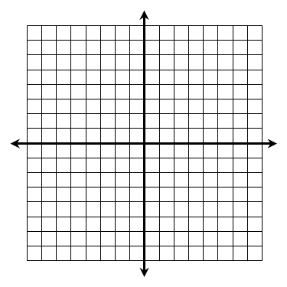
20. Solve the system below by graphing.
21. Solve the system below by substitution.
22. Solve the system below by elimination.
23. Solve the system below by elimination.
24. Which system of equations has an infinite solution?
A.
B.
C.
D.

Slide 5


25. Jasmine bought 1.3 pounds of ham and 0.8 pounds of cheese from the deli and paid $11.28. She went back the following week and bought 1.5 pounds of ham and 1.2 pounds of cheese and paid $14.76. If the prices remained the same, find the price per pound of ham and cheese.
Ham:
Cheese:
26. Solve the system below.
27. Which ordered pairs represent solutions to the linear inequality below? Check all that apply.
(1, -8)
(-8, -3)
(-12, 0)
(3, 5)
(-7, 9)
(-4, 2)

Slide 6

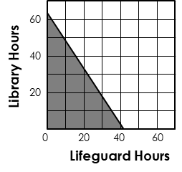
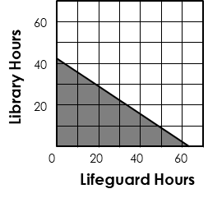
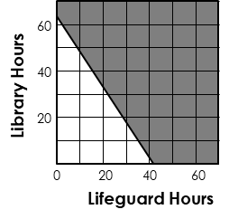
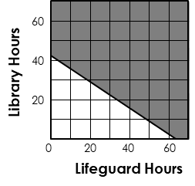
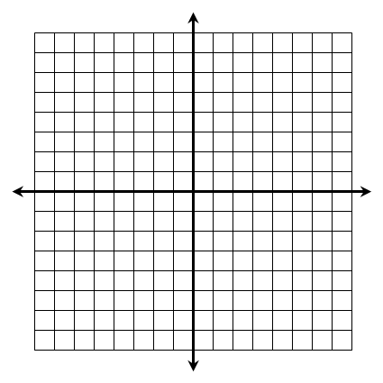
28. Jon makes $12 per hour as a lifeguard and $8 per hour working at the library. This summer, he would like to make at least $500 working his two jobs. Which graph represents the number of hours he must work at each job to reach his goal?
A.
C.
B.
D.
29. Graph the system of linear inequalities. Then, choose the point that represents a solution to the system.
A. (-6, 1)
B. (4, 0)
C. (1, 8)
D. (-3, -7)
30. To save money for prom this weekend, Tom is going to walk his neighbor’s dog for $6 per hour and wash cars for $7.50 per hour. His mother said he can work no more than 15 hours to ensure he keeps up with his homework. Tom needs to make at least $75 to cover prom expenses. If d represents the number of hours walking his neighbor’s dog and c represents the number of hours washing cars, which system of inequalities represents this situation?
A.
B.
C.
D.

